Slide 1
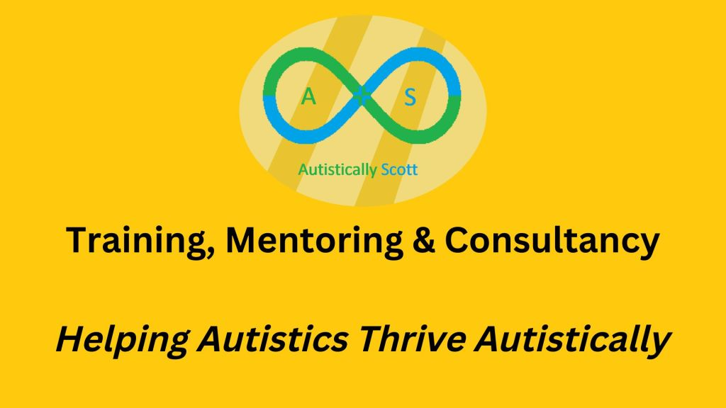

Autistic Information Session
Autistically Scott, 2024

Slide 2

House keeping
Movement breaks
Stim tools
Flap, don’t clap
Feel free to ask questions
Autistically Scott, 2024

Slide 3
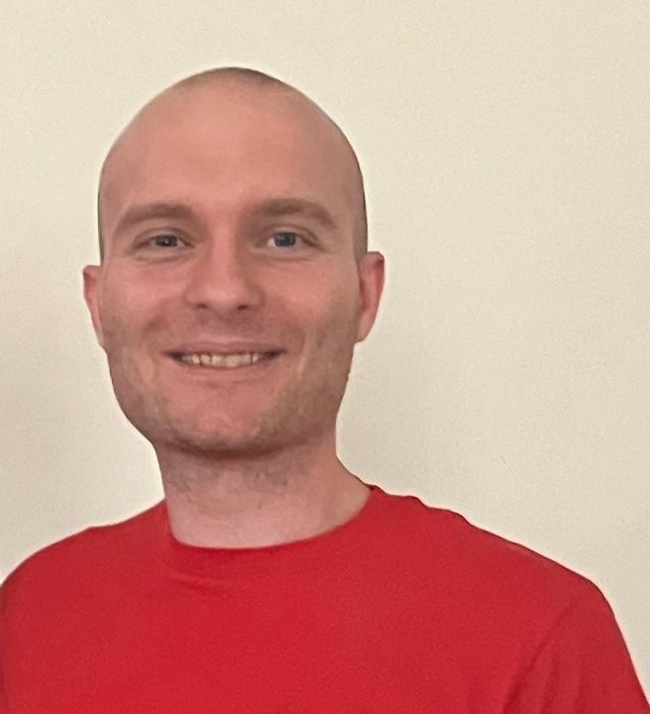



Who am I?
Scott Neilson
Autistic Trainer, Mentor and Consultant.
Personal & Professional experience
Helping Autistics Thrive Autistically
References and visuals by Autistic people
I also work with:
Autistically Scott, 2024
Notes:
‘Diagnosis’ carries so much stigma for any child or adult and family. Suggests something is wrong but there’s not. How can we have positive identity if we are fed this from beginning?

Slide 4
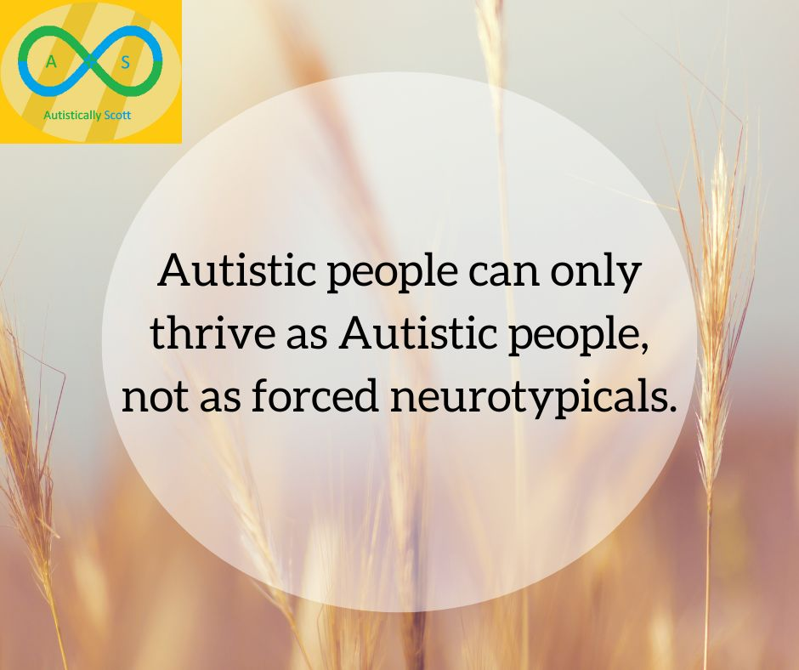
Autism + Environment = Outcome
(Dr. Luke Beardon, 2017)
Autistically Scott, 2024
Notes:
Only thrive as ourselves. Being Autistic is neutral. It can be disabling in a world not compatible for us and it’s important to get the environment right. Conflicting needs make accessibility difficult but we can do as much as possible to adapt to people.

Slide 5
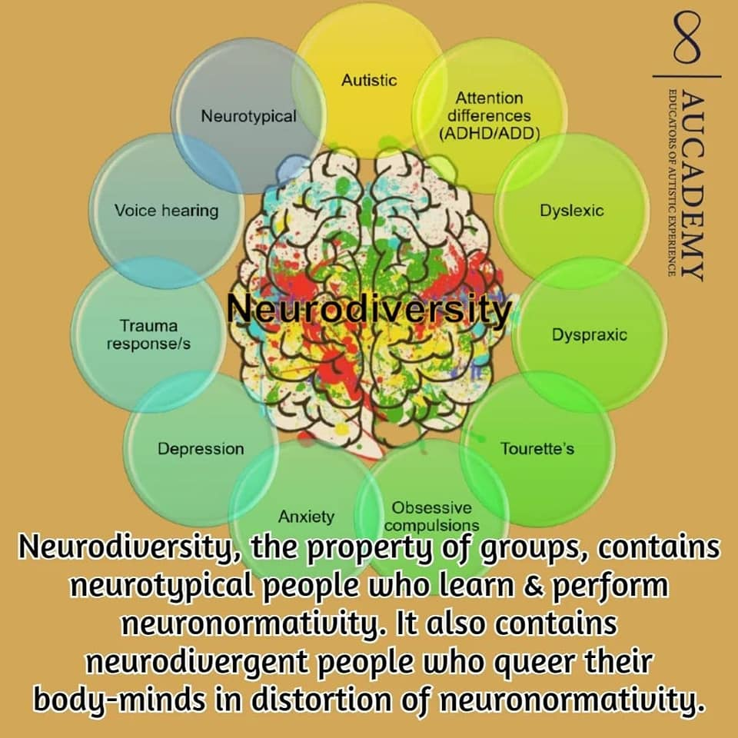
Co-occurring conditions
Fibromyalgia
Hypermobility
IBS
Chronic illnesses
Health conditions study - https://www.cam.ac.uk/research/news/autistic-individuals-have-increased-risk-of-chronic-physical-health-conditions-across-the-whole-body
Disbelief of CYP pain study - https://pressreleases.responsesource.com/news/104052/new-research-backed-paper-warns-that-diagnosis-delay-and-symptom-disbelief/
Autistically Scott, 2024
https://neuroqueer.com/neurodiversity-terms-and-definitions/
Notes:
Likely to be multiply neurodivergent, or co-occur with conditions like EDS and mobility issues. Study showing disbelief of medical conditions such as hypermobility and pain this can cause Autistics, especially as they mask and suppress this.

Slide 6
Autistic Communication
Eye Contact
Echolalia – repeating words/sounds we hear
Honesty e.g., "you look like crap”
Situational Mutism – lose ability to speak
Language Processing (how was your day?)
Info dumping
Literal thinking
Autistically Scott, 2024
https://journals.sagepub.com/doi/full/10.1177/1362361320919286
Rachel Cullen - https://aucademy.co.uk/rachel-cullen-they-them/
Notes:
Some who don’t speak. Autistic communication very effective in Autistic groups per research and insight. We have our own way of communicating. Just as effective in Autistic groups but broke down in mixed groups per research by Catherine Crompton (2020). https://journals.sagepub.com/doi/full/10.1177/1362361320919286

Slide 7
Tips for Communication
Be specific with words “What did you eat at lunch?”
Presume Competence
Break tasks or activities down into steps
Let us info dump!
Utilise AAC (text, drawings, pictures, devices)
Avoid giving too many questions or information.
Opportunity for person to ask clarifying questions
Autistically Scott, 2024
Notes:
May ask to repeat questions or for more information to understand, sometimes repeating questions could be a sign of anxiety for a person.

Slide 8
Aspects of Being Autistic
Monotropism
Spiky Profile
Autistic Play
Learning Styles
https://monotropism.org/
Autistically Scott, 2024

Slide 9
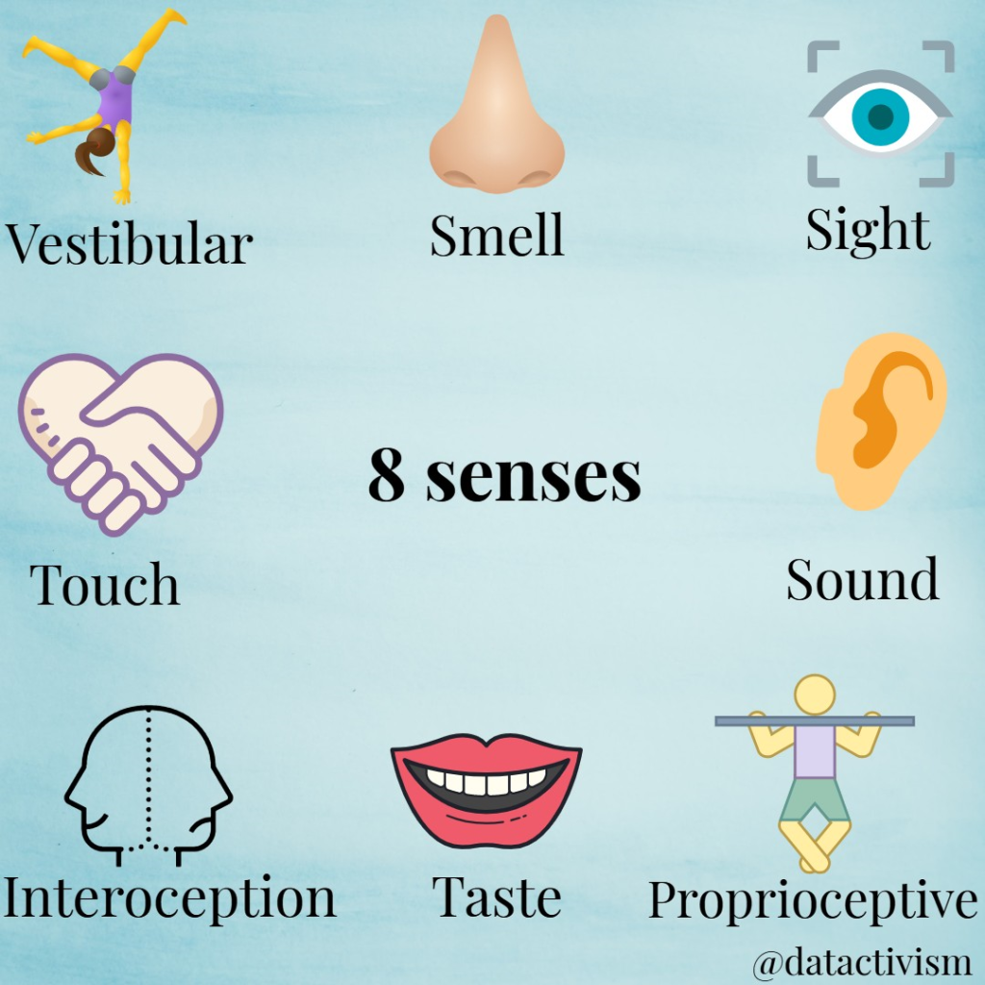
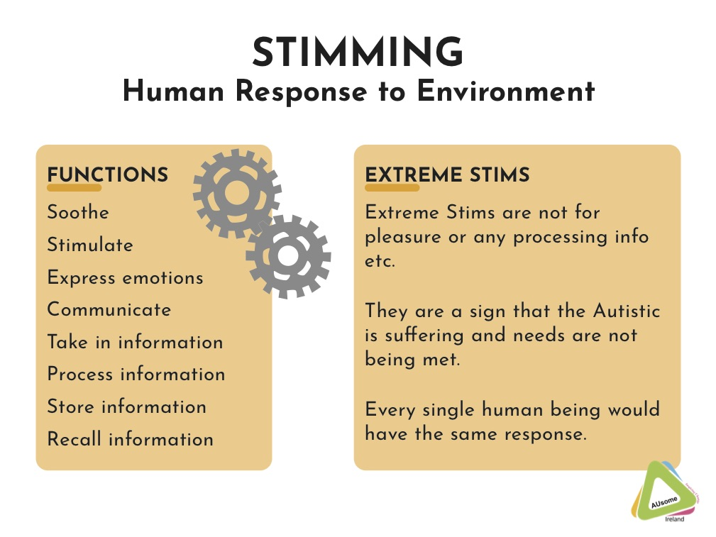









Sensory needs
Autistically Scott, 2024

Slide 10
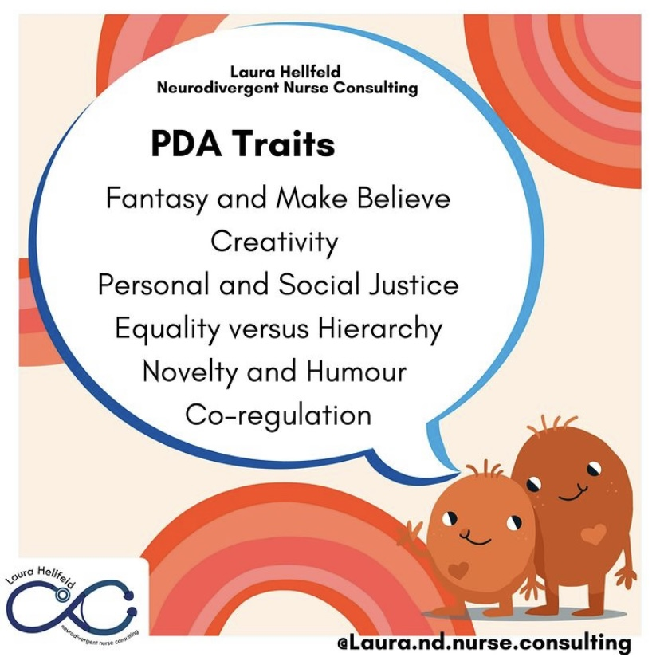
PDA (Persistent Drive for Autonomy)
PDA Autistics experience high anxiety at the threat of their autonomy being taken away.
Supporting PDAers:
Indirect communication
Shared goals and collaborations
Reduce expectations and demands
Give flexibility and choices
Focus on their intrinsic motivation
Autistically Scott, 2024

Slide 11
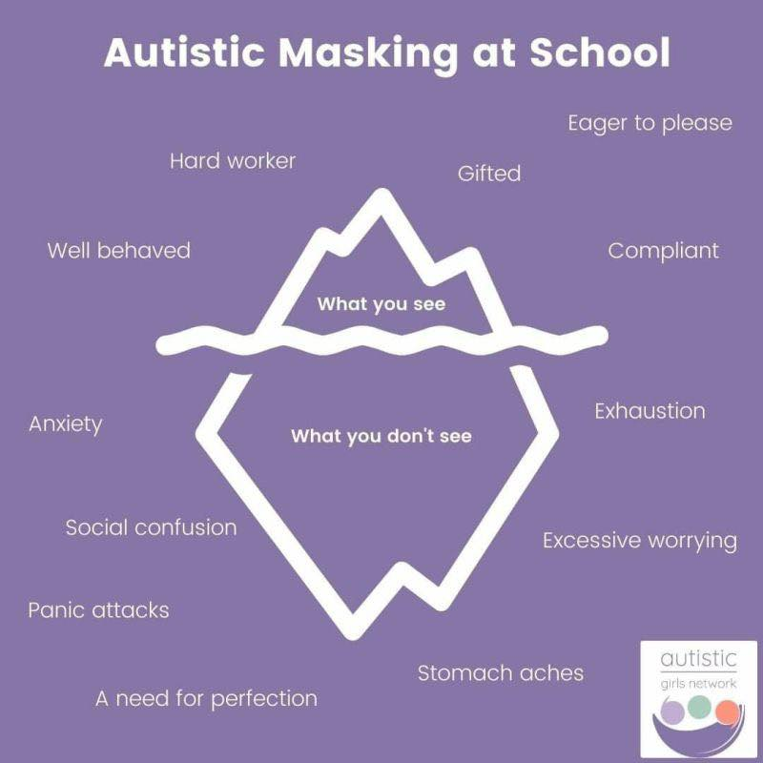
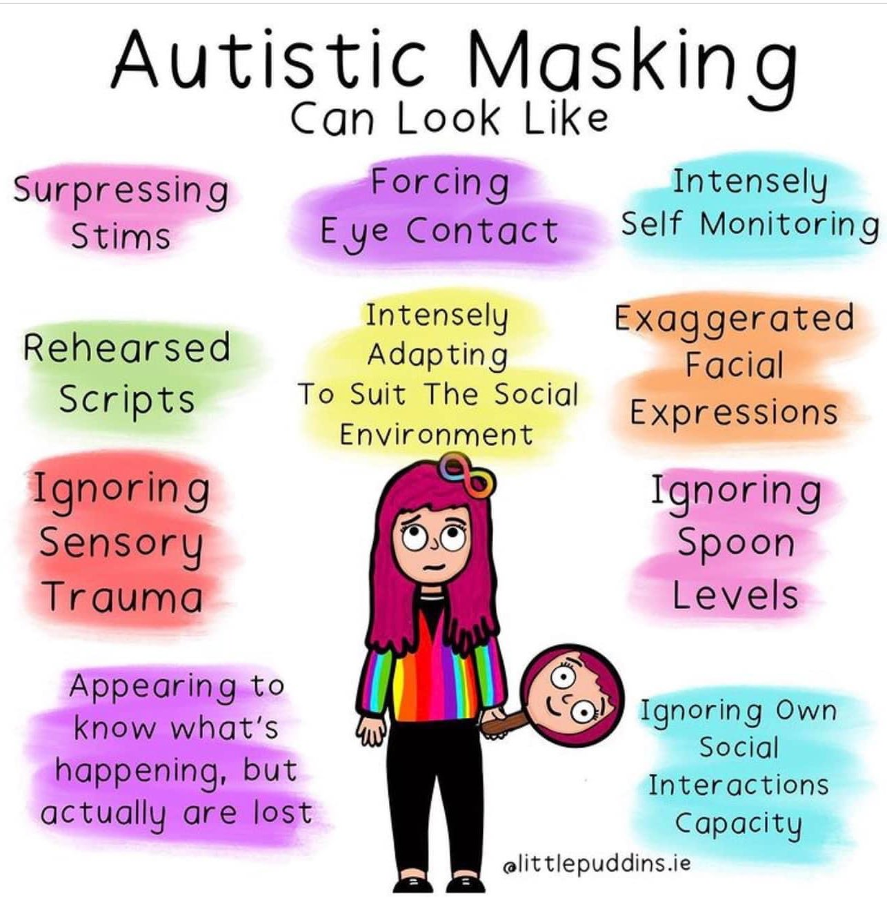
Autistic Masking
Masking & mental health - https://pubmed.ncbi.nlm.nih.gov/31820344/
Autistically Scott, 2024

Slide 12
Visuals
Visual timetables
Area markers
Timers
Staff images
Countdowns
Autistically Scott, 2024
Notes:
Now and next for going to next activity – visual time tables. Markers for circuit areas and what each part is – sports or movements like jumps, squats etc. Visual timers for transitioning to next activity or stage. Boardmaker used in many schools. Keeping it consistent.

Slide 13
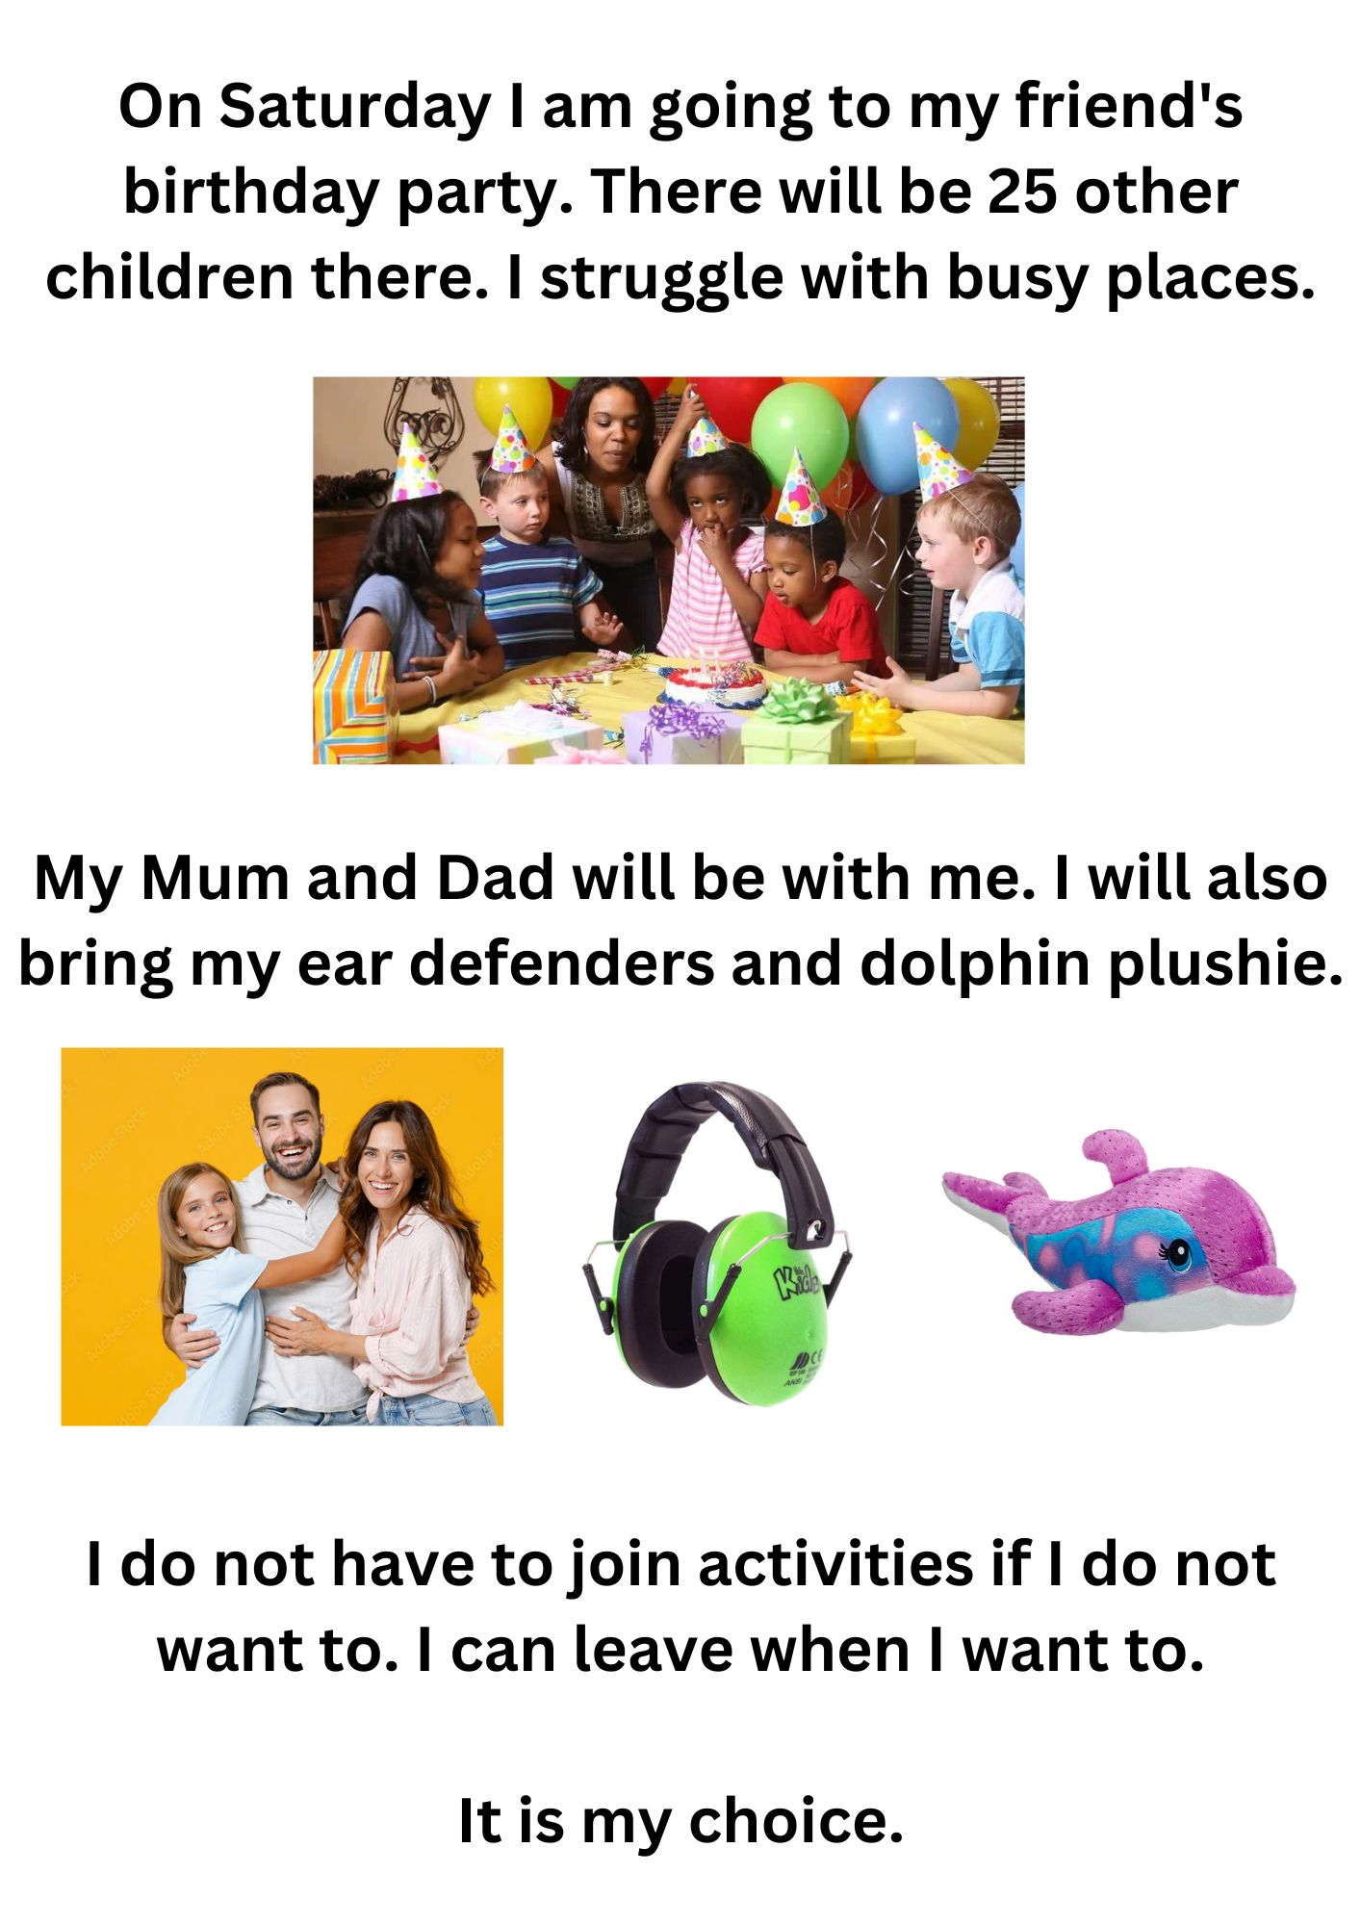
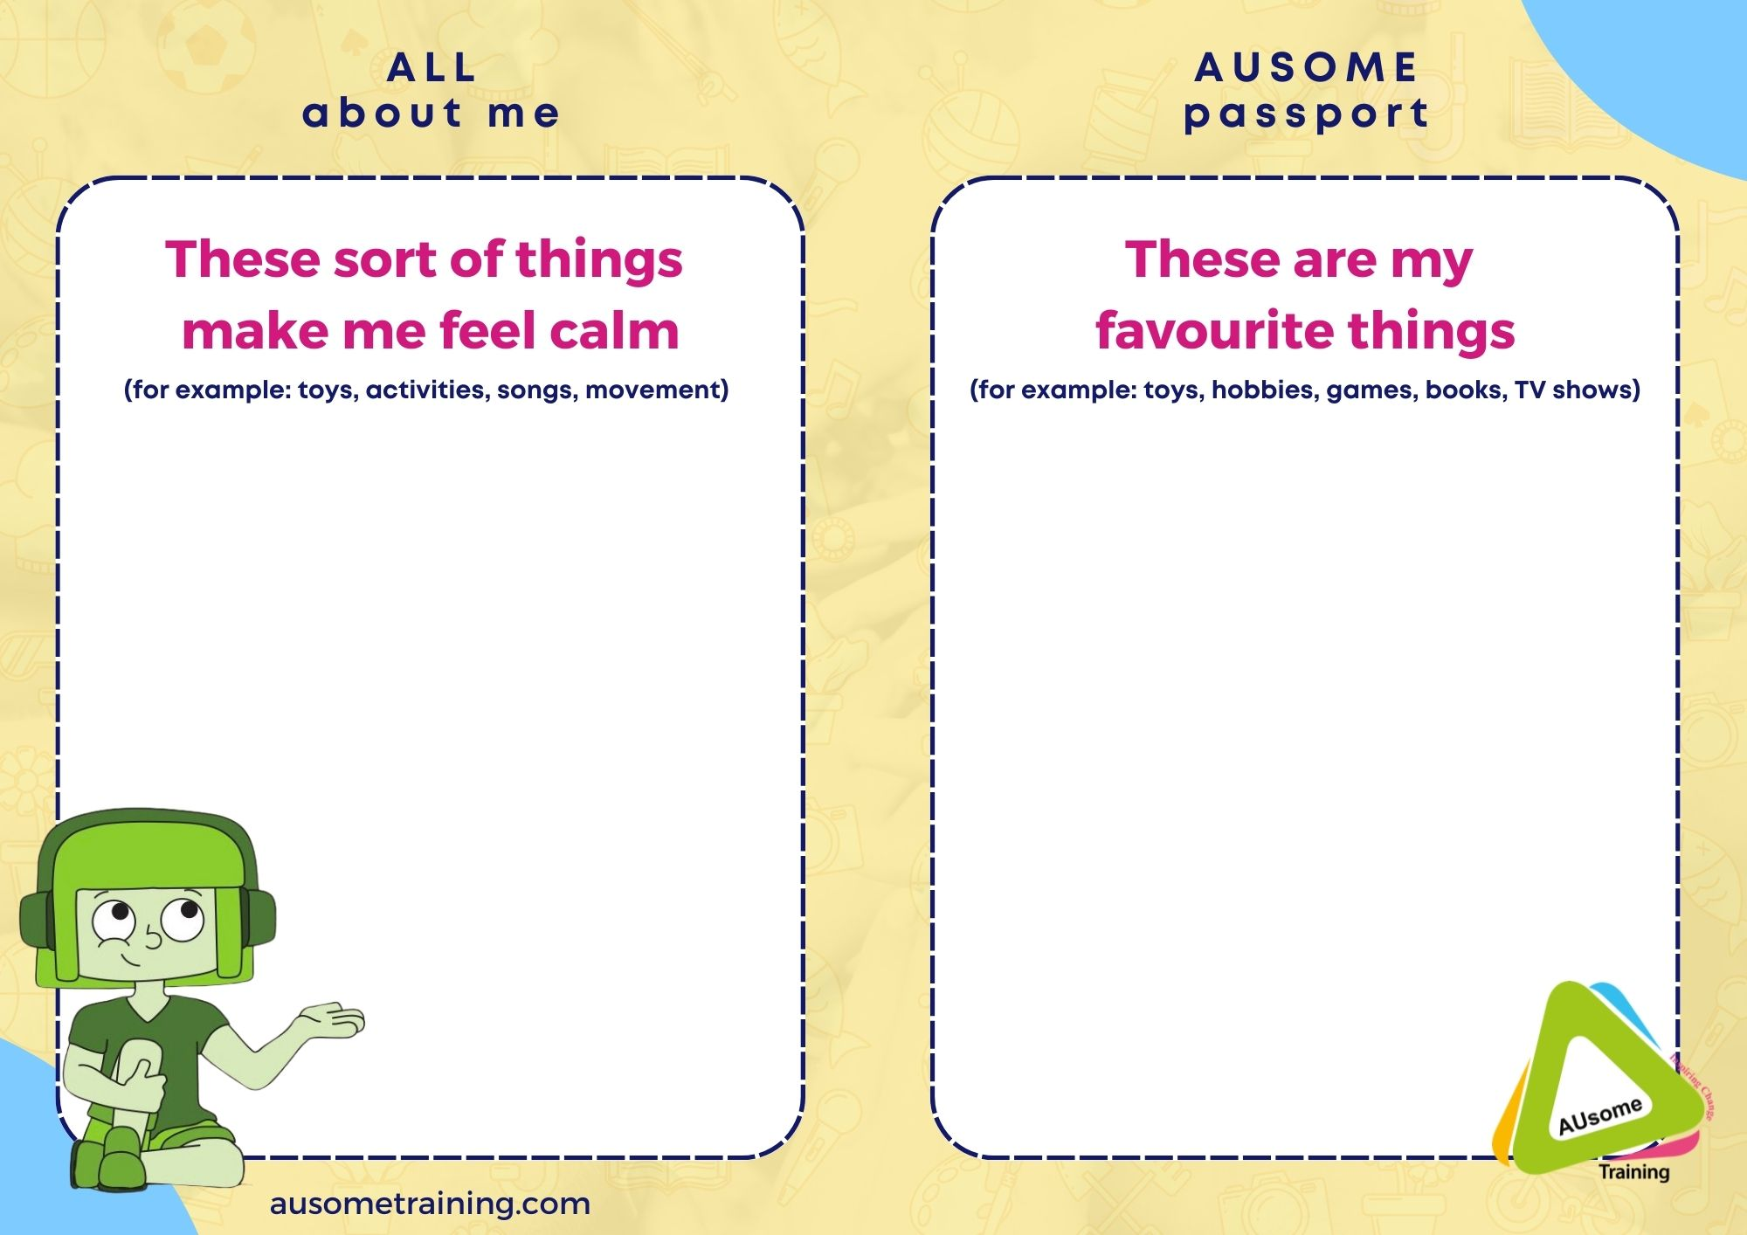
Neuro-affirming Guides & Passports
Autistically Scott, 2024
Notes:
Some may like real images for transitions to new activities or venues.

Slide 14
Other Supports
Flexibility with uniform and clothing
Use communication and sensory profiles
Time to decompress
Gentle reminders with transitions
Teach young person about differences
Accepting monotropic flow
Autistically Scott, 2024
Notes:
Lunch clubs for Autistic people to meet and connect. Find ways through shared interests or after school clubs. Sensory needs, such as balance, body awareness, these can help our wellbeing and sports offers chance for that.

Slide 15





Autistic Joy
Sensory bliss
Stimming
Internal joy
Joy from Interests
Interests help wellbeing
Autistically Scott, 2024
Notes:
Joy – mountain? What about nature, pets, football, games, gardening, watching movie or reading a book, amusement park, concert.
Also being shamed for joy. How this can impact identity and sense of self and cause more masking.

Slide 16
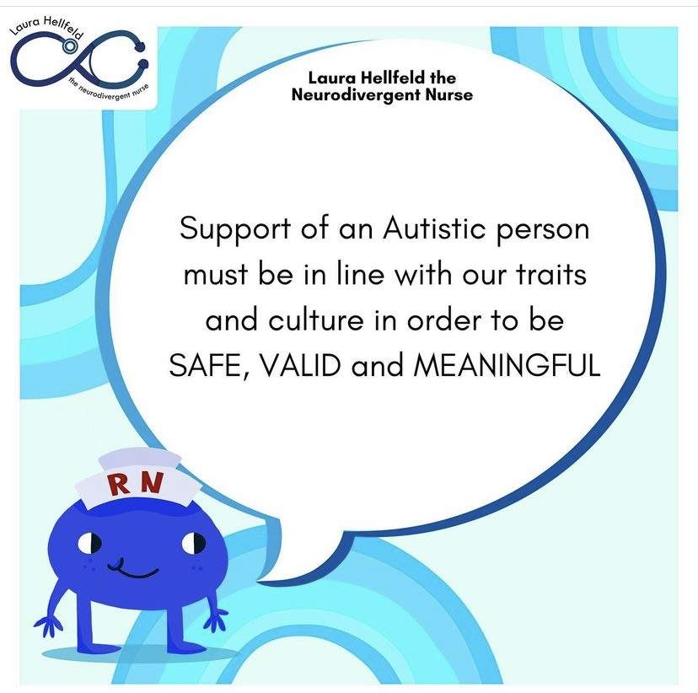
Autistically Scott, 2024
Notes:
Our culture and expressions and shared experiences. It reinforces why we can only thrive as ourselves, not as people whose neurology is vastly different to our way of being. Cannot unqueer a queer person nor can you stop ND people being ND and Autistics from being Autistic. Reinforces Neuro-affirming and the shift to ND Paradigm. It’s not just conforming to one way of being, there’s no one form of education, a school environment is not for every child or every pupil. There are more ways to be human and to exist on this planet.

Slide 17
Signposting
AUsome Training (training & resources)
GROVE Neurodivergent Mentoring & Education (mentoring, groups, training)
Scottish Women’s Autism Network (training & information)
Scottish Ethnic Minority Autistics (training & information)
Laura Hellfeld Neurodivergent Nurse Consulting (PDA, food, sleep)
Danny with Words (Non-speaking advocate)
Autistic and Living the Dream (Autistic & LGBTQ+ experiences)
Autism with a pinch of SaLT (Speech and Language Therapist)
Viv Dawes The Autistic Advocate (Autistic Burnout)
NeuroWild (Speech and Language Therapist, Infographics)
NT in a ND World - https://www.nt-in-a-nd-world.com/
Autistic Revolution (Online magazine)
Autistically Scott, 2024

Slide 18
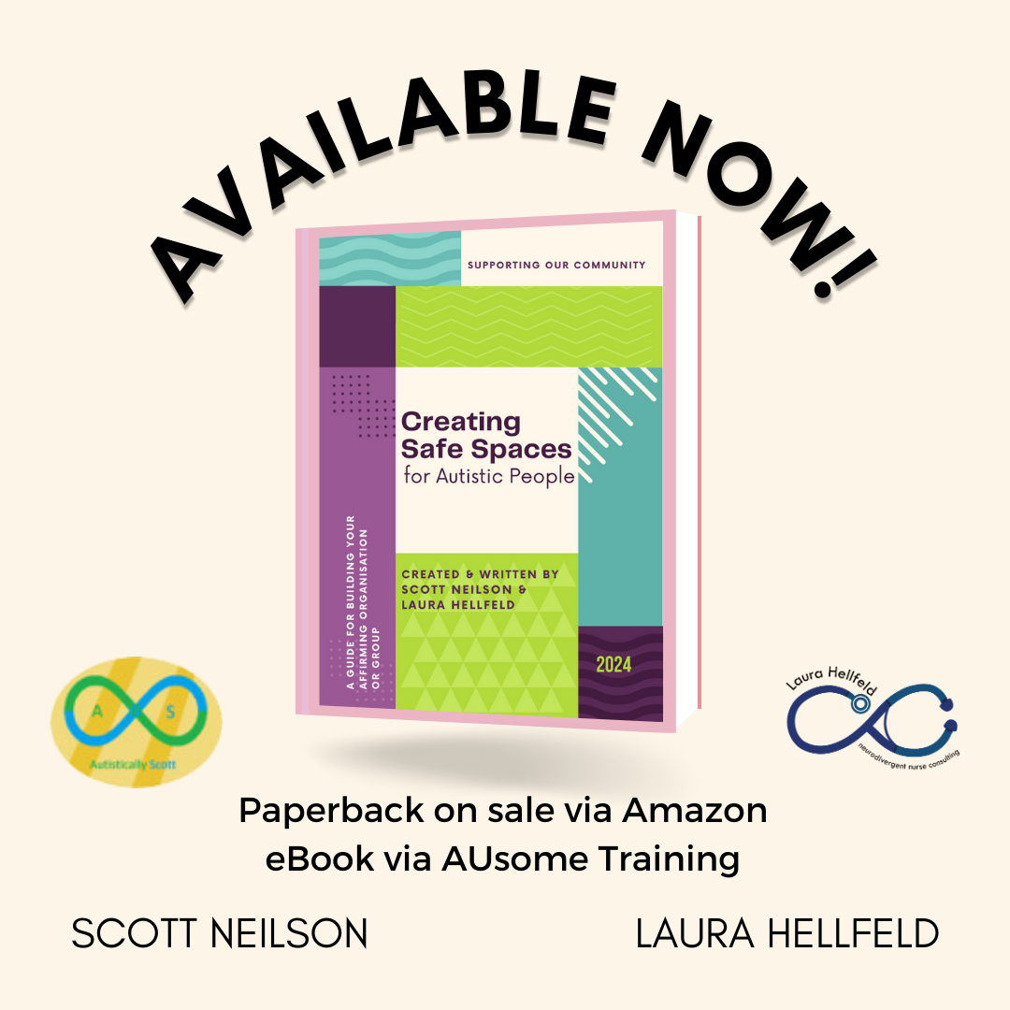
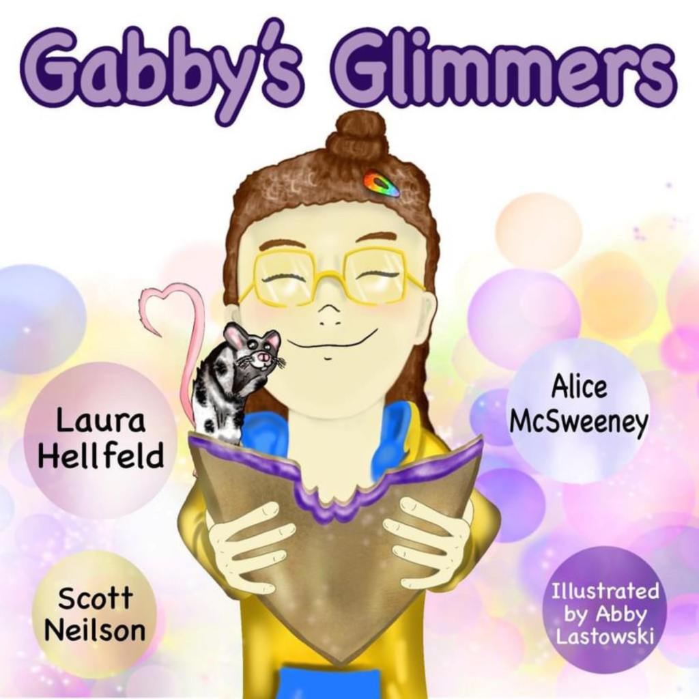
Website: Autisticallyscott.uk
Facebook: https://www.facebook.com/AutisticallyScott
Email: autisticallyscott@gmail.com
Autistically Scott, 2024

